Slide 1
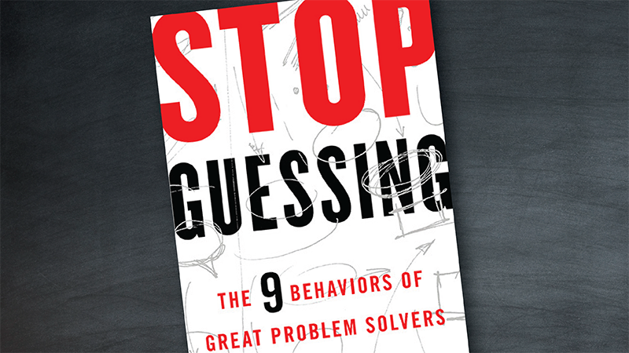
Presented By,
Arun Anantha Raj Eswaran

Slide 2
Summary
Why difficult issues require thoughtful problem-solving strategies
Why having a strategic approach is better than guessing, brainstorming or following hunches
How to use nine strategic behaviors to resolve knotty problems.

Slide 3

Dealing with Issues
Have you ever been forced to accept certain problems because you didn’t think you could do anything about them?
You might have attempted to address them and not succeeded.
You may even have thrown money at these issues to circumvent them.
Instead, follow the example of great problem solvers who use a consistent set of “behaviors” to solve the most difficult issues

Slide 4

Stop Guessing
“Guessing is a natural brain function”.
In our evolutionary history, humans had to quickly make decisions with very limited information.
Acting too quickly encourages “solution guessing” rather than “problem solving.”
Guessing at a solution may work when a problem has two or three possible root causes.
When leaders guess at solutions, because of their experience.

Slide 5

Smell the Problem
When you seek to solve a problem in any area, you need to smell the problem.
Before you start looking for information, decide which questions you want answered.
Good problem solvers overcome obstacles to obtain the information they need.
“Digging up information that yields insight and decision is the backbone of any problem-solving effort.”

Slide 6

Embrace Your Ignorance
Outstanding problem solvers know when they confront a new problem that they must learn from scratch.
They don’t try to convince others that they already know the answers.
Accepting that you don’t know is often difficult, but it’s necessary.
Skilled problem solvers aren’t afraid to acknowledge that they don’t know something.

Slide 7

Know What Problem You’re Solving
Tackling a difficult problem requires specifying its parameters as precisely as possible.
Derive your definition from your personal observations.
One of the most effective approaches for defining a problem requires determining if it has a “measurable variable.”
You can’t be sure that you’ve defined the problem correctly.

Slide 8

Dig into the Fundamentals
You can’t expect to understand how all systems work.
Be aware that trying to learn everything about a complex system in order to solve a problem within it can be overwhelming.
Seek to learn only as much about the system as you need to resolve the problem.

Slide 9

Don’t Rely on Experts
Experts may not always be able to help.
Use experts to tell you which parts of a system you need to investigate.
Don’t use them to give you a solution.
Ask them to help you understand an element of a system.

Slide 10

Believe in a Simple Solution
You must be able to demonstrate how the problem occurs.
Most people have poor problem-solving skills, so they become accustomed to devising complicated solutions for most problems.
In organizations they often discount simple solutions.

Slide 11

Make Fact-Based Decisions
In Michael Lewis’s book Paul DePodesta, a young Harvard graduate, suggested that baseball teams should select players on the basis of their statistics.
Verify that your information is accurate and that no one manipulated the data.
Decide how much confidence you have in the data.

Slide 12

Stay on Target
Knotty problems in complex systems can have numerous root causes.
They make you focus and refocus your attention.
Skilled problem solvers hold two contradictory thoughts.
They believe they have the skills to solve problems and they acknowledge that they could fail if they don’t pay attention.

Slide 13

Life’s just better when you believe you can resolve something.
As a problem solver of any system – be it a machine, a circuit, a code base, your body or your habits – your mission is to smell the problem.

Slide 14


